Slide 1
Analyzing Student Academic Performance
By: William Chen, Alexander Cheung, Shivtej Lakkakula, Steven Pham, Nicholas Tang
Notes:
-steven

Slide 2
Table Of Contents
Introduction: Problem Statement
Dataset Context
Data Preparation Process
Research Question Answers
Models
Recommendations
Notes:
-steven

Slide 3
Problem Statement
Notes:
-steven

Slide 4
Purpose of Our Analysis
The purpose of analyzing a dataset for student performance is to identify factors that influence academic success.
Specifically, the analysis aims to understand how students allocate their time across various activities (study, leisure, work, etc.) and how these allocations correlate with academic outcomes, such as exam scores.
By gaining insights into these patterns, educational strategies can be improved to support student success, enhance time management practices, and identify areas where interventions may be most effective.
Notes:
-NICK

Slide 5
Data Context
Notes:
-steven

Slide 6
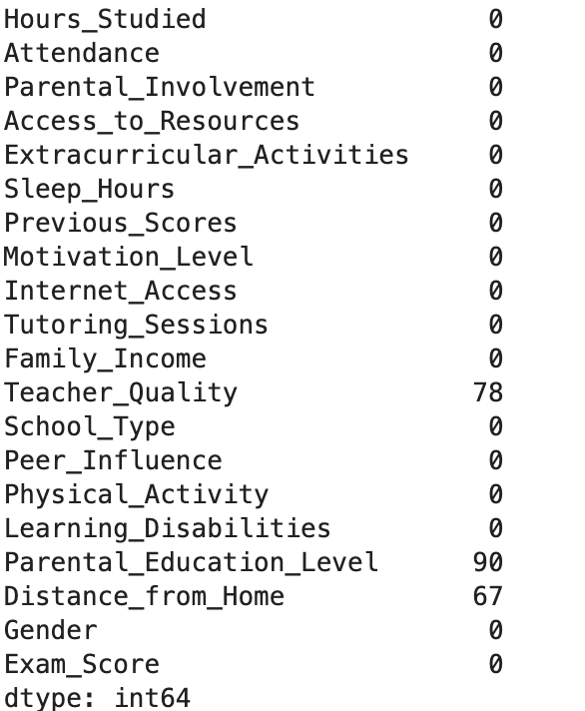
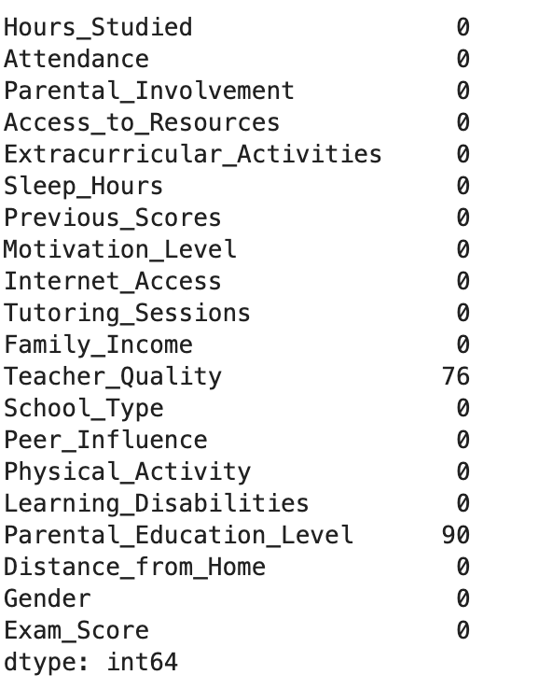
Limitations
Notes:
-steven

Slide 7
Data Dictionary
Strings:
[‘Parental_Involvement', 'Access_to_Resources', 'Extracurricular_Activities', 'Motivation_Level', 'Internet_Access', 'Family_Income', 'Teacher_Quality', 'School_Type', 'Peer_Influence', 'Learning_Disabilities', 'Parental_Education_Level', 'Distance_from_Home', 'Gender']
Integers:
['Hours_Studied', 'Attendance', 'Sleep_Hours', 'Previous_Scores', 'Tutoring_Sessions', 'Physical_Activity', 'Exam_Score']
Notes:
-ALEX

Slide 8
Data Preparation Process
Notes:
-steven

Slide 9
Research Questions
How does the time allocated to different types of activities (study, leisure, work, etc.) influence student success?
This would help uncover the balance between study time and other commitments, and its impact on academic results
How does a student’s attendance and motivation affect student success and learning outcomes?
Investigating the role of mental capacity and performance can lead to recommendations on student lifestyle adjustments.
How does the distance from home to school impact student performance, and what measures can mitigate potential negative effects (e.g., fatigue or reduced study time)?
This can lead to insights on how transportation or proximity to school affects academic success.
Notes:
-WILL

Slide 10
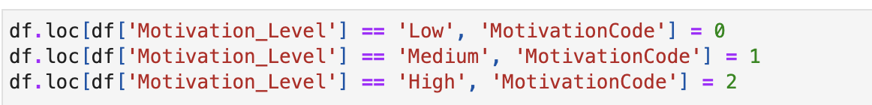
Data Cleaning & Preprocessing
Preprocessing
Data Cleaning
Identified missing or inconsistent data type values
Notes:
-STEVEN
Exam scores are primarily in the 60-80 range
Simplifying analysis
If there are very few scores in the 90 range, these outliers may not contribute significantly to the analysis and could skew results in some statistical models. By grouping scores into broader categories, we can address the imbalance in the dataset.

Slide 11
Exploratory Data Analysis & Tools
Applications
Libraries
Pandas
Seaborn
Sklearn
Matplot
Python
Jupyter Notebook
Tableau
Notes:
-SHIV

Slide 12
Research Question
Answers
Notes:
-steven

Slide 13
Research Question 1
How does the time allocated to different types of activities (study, leisure, work, etc.) influence student success?
Notes:
-steven

Slide 14
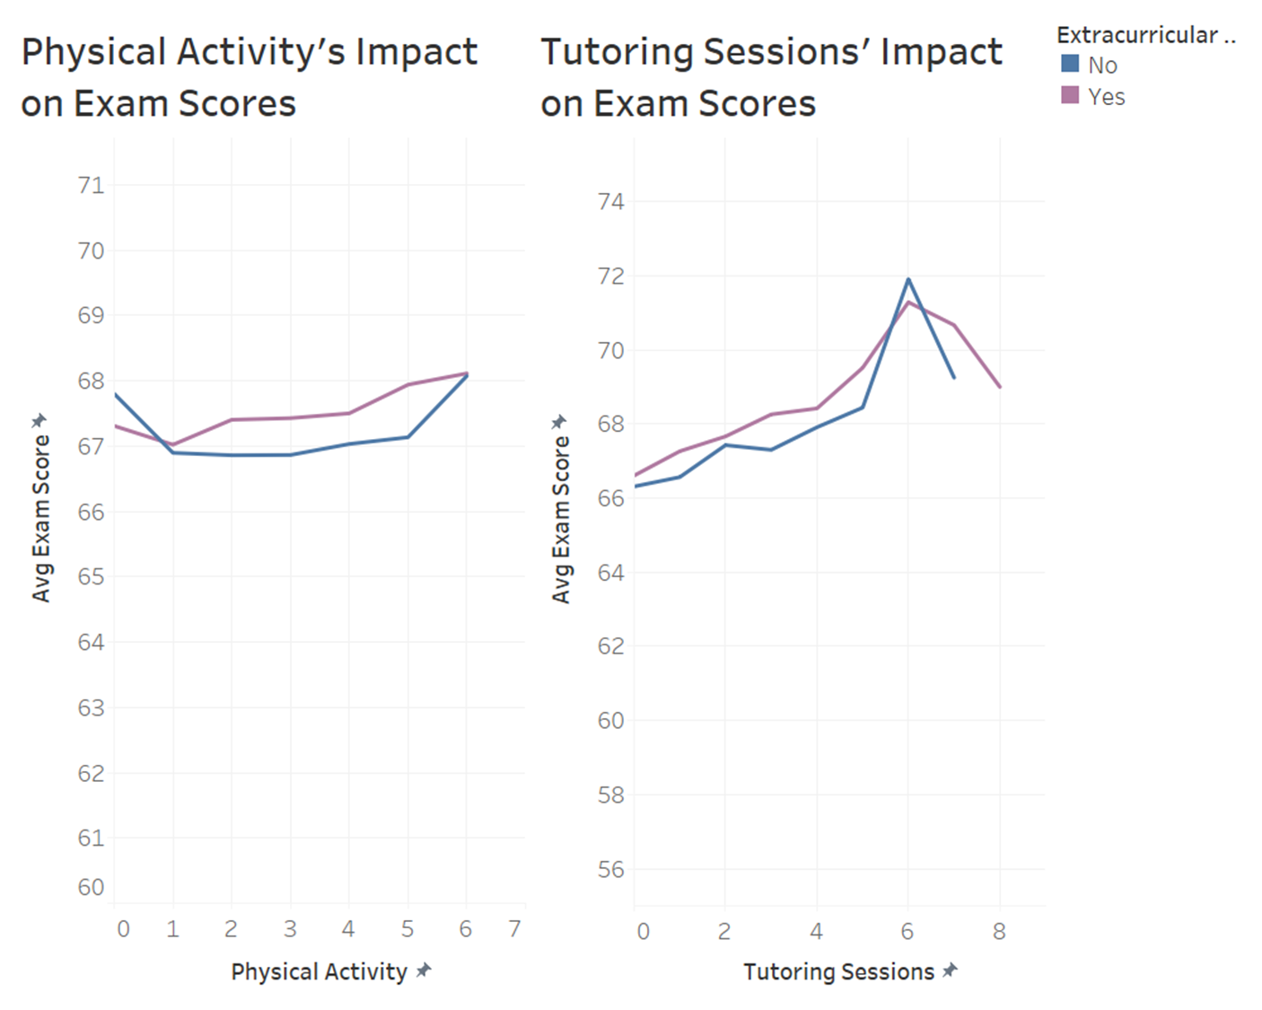
Data divided into 2 categories
EC Participation vs No ECs
Both physical activity and tutoring sessions will boost exam scores
However, too many tutoring sessions may cause burn out
Overall impact of tutoring sessions is higher than Physical Activity
Around a 7.6% boost in scores from 0 sessions to 5 tutoring sessions
Notes:
(WILL)
Divided data into 2 categories, those who participated in ECs and those who didn’t.
Physical Activity: it actually appears the more time spent on exercising actually boosts Exam scores.
Could be due to the mental benefits from the stress relief of exercising
Tutoring sessions:
More = Higher Exam Scores
*To a certain extent. More than 6 sessions can cause burnout
Tutoring Sessions w/ EC’s:
Too much for students to handle if they have >5 tutoring sessions. Can see a large drop off in scores
Comparison
Student who aims to raise their test scores -> prioritize tutoring sessions as impact is higher
Try not to get burnt out by having too many things on your plate
In both charts, those who participate in EC’s normally score higher than those who don’t

Slide 15
Research Question 2
How does a student’s attendance and motivation affect student success and learning outcomes?
Notes:
-steven

Slide 16
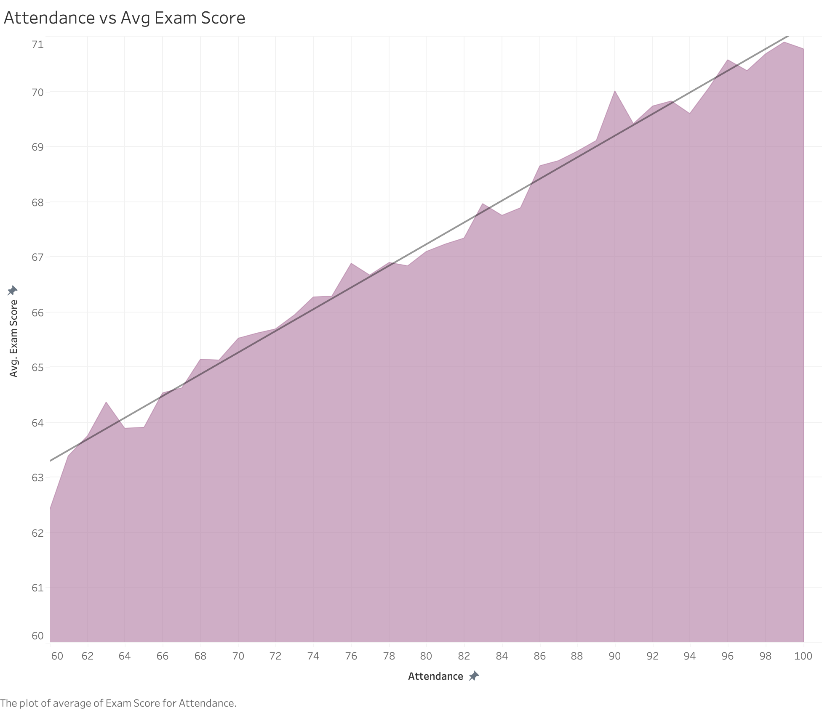
Attendance VS. AVG Exam Score
AVG Exam score is 67.089%
As attendance increases, the average exam score also increases, showing a clear correlation.
Positive Trend Line
At lower attendance levels (around 60-70%), average exam scores are between 60-65.
Higher attendance (80-100%), scores range from 67-71.
Notes:
ALEX

Slide 17
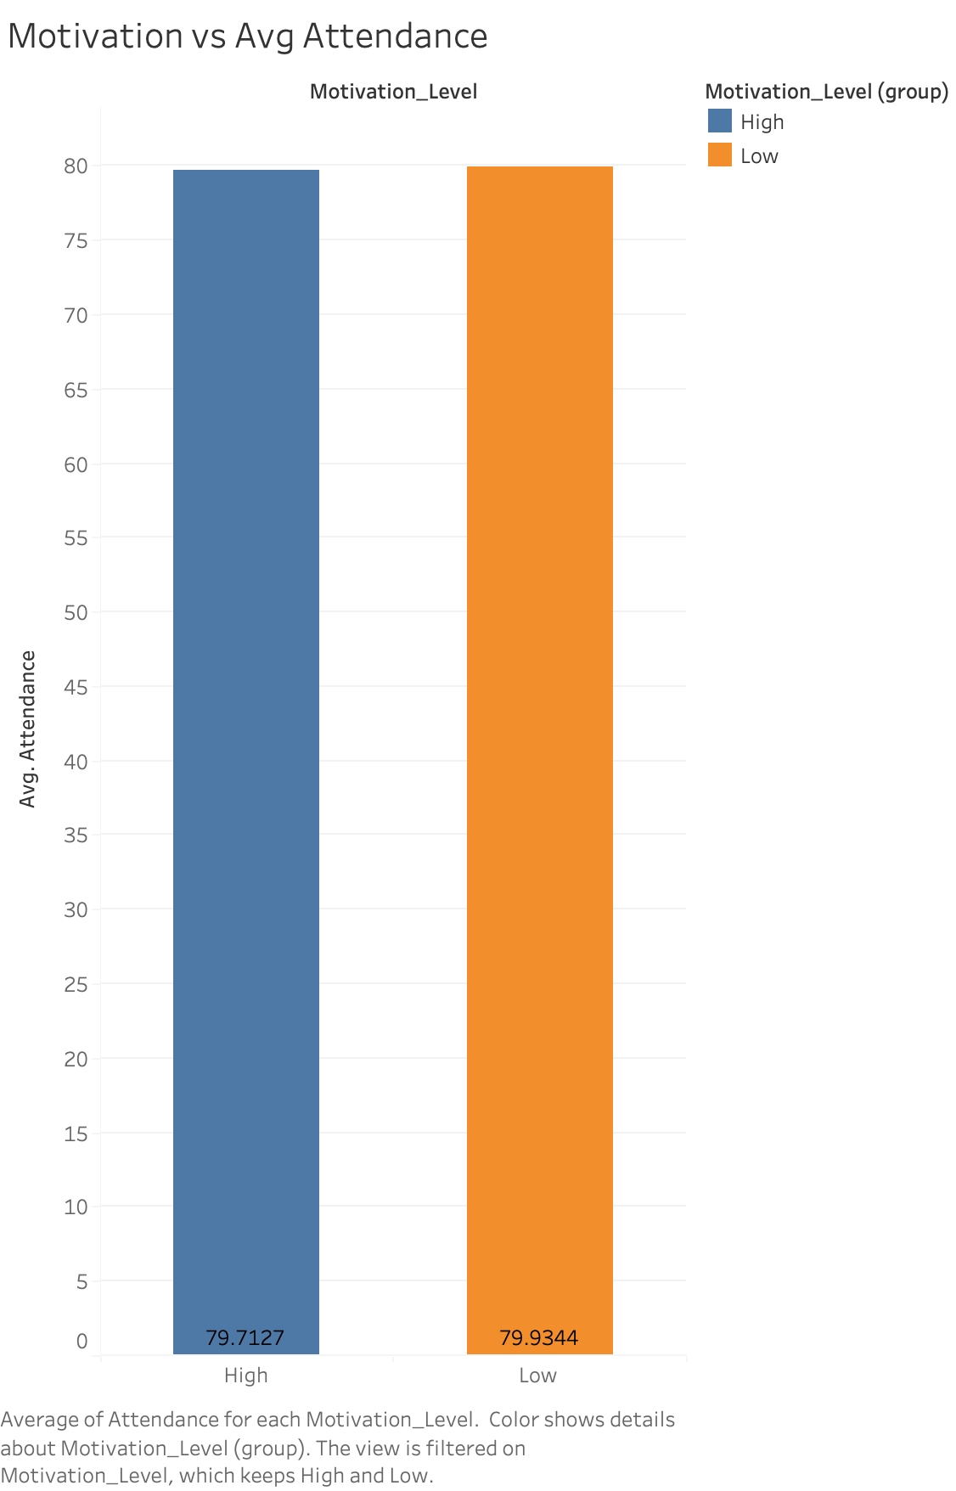
Motivation vs. AVG Attendance
Average Attendance Levels:
The average attendance for the High Motivation Level group is 79.71%.
The average attendance for the Low Motivation Level group is 79.93%.
Key Insight:
The difference in average attendance between the two groups is negligible. Despite the expectation that high motivation would correlate with significantly better attendance, this data suggests both groups maintain nearly identical attendance levels.
Notes:
ALEX

Slide 18
Research Question 3
How does the distance from home to school impact student performance, and what measures can mitigate potential negative effects (e.g., fatigue or reduced study time)?
Notes:
-shiv

Slide 19
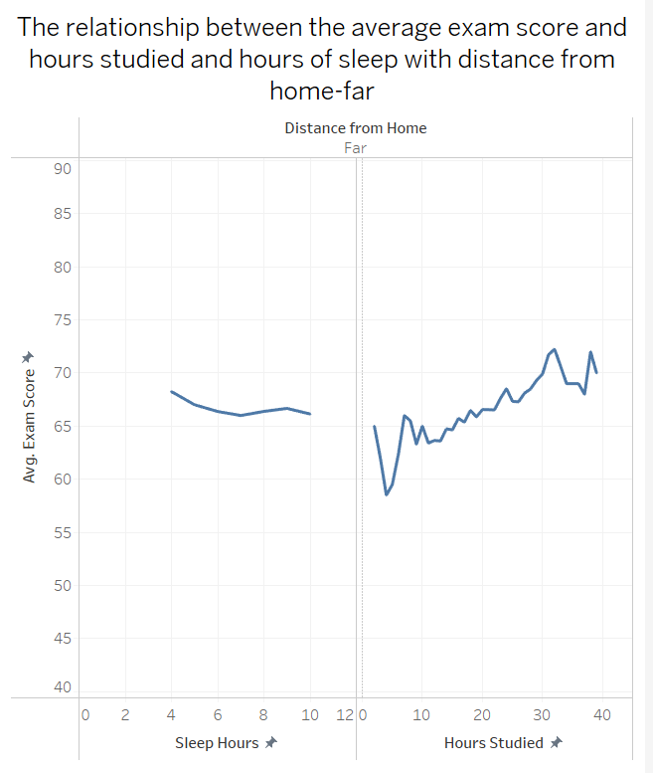
There is a noticeable increase in average exam scores with increasing study hours, indicating a positive correlation between study time and performance for students living far from home.
Sleep hours, however, seem to have a less consistent relationship with exam scores, as shown by the relatively flat line, suggesting that sleep does not significantly impact exam scores for these students.
Notes:
SHIV

Slide 20
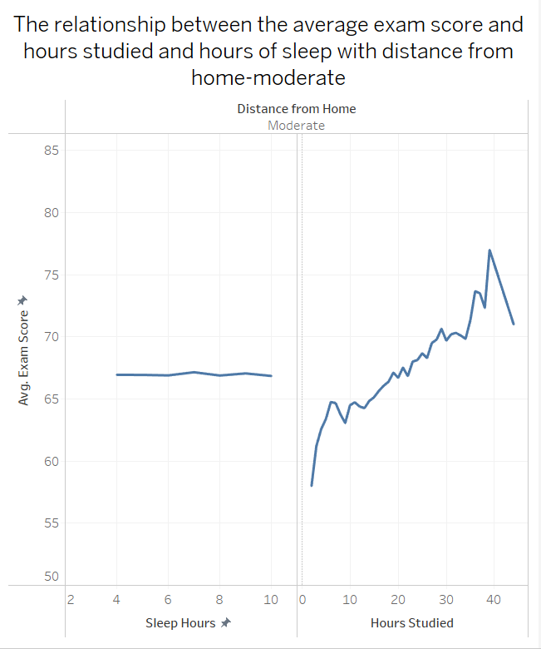
There is a dramatic rise in average exam scores as study hours increase, peaking at around 40 hours before seeing a sharp decline. This could indicate that a moderate amount of studying is optimal, with too much potentially leading to burnout or decreased efficiency.
Similar to the "far" group, sleep does not display a strong correlation with exam scores, maintaining a steady trend across different sleep hours.
Notes:
SHIV

Slide 21
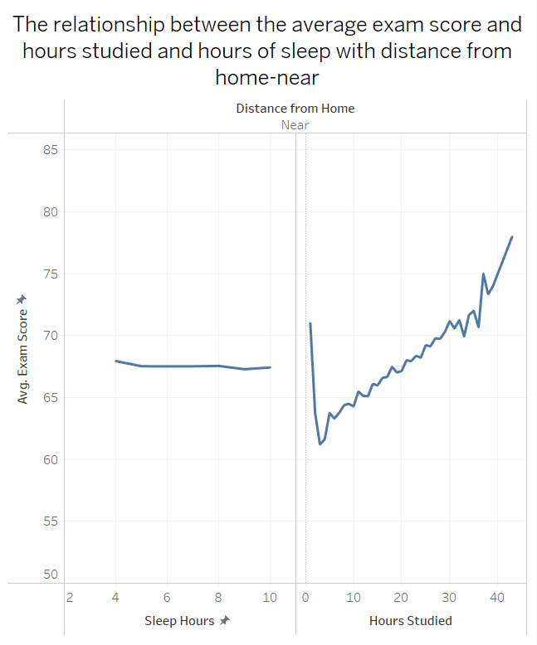
There is a steep increase in exam scores with more hours studied, suggesting that students who live near their place of education might find more effective or intensive study patterns.
As with the other groups, the relationship between sleep hours and exam scores remains relatively flat, implying little to no impact of sleep on exam performance for these students.
Notes:
SHIV

Slide 22
Models
Notes:
-steven

Slide 23
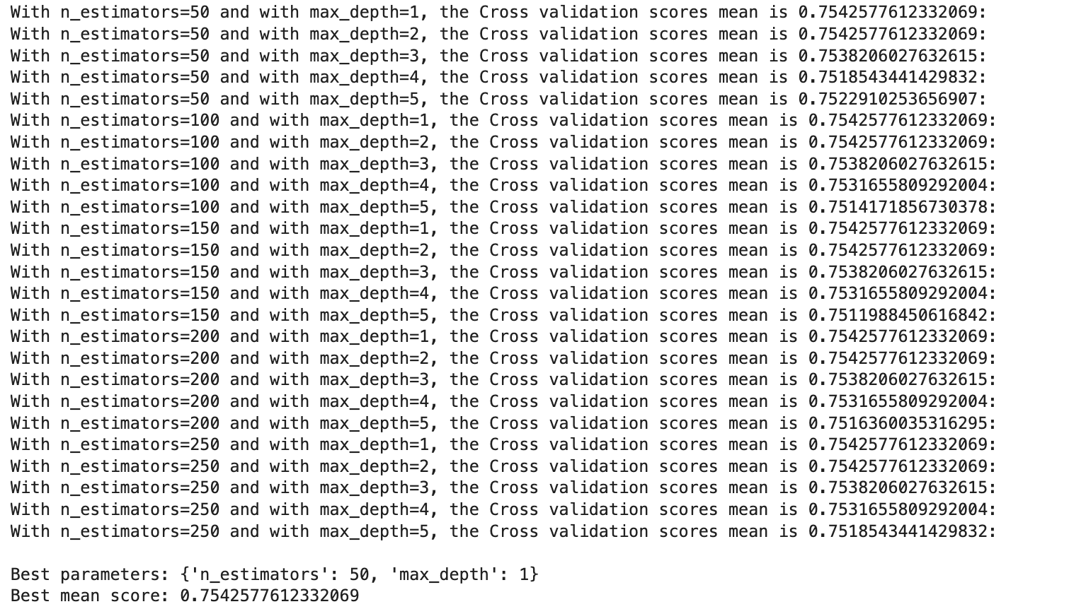
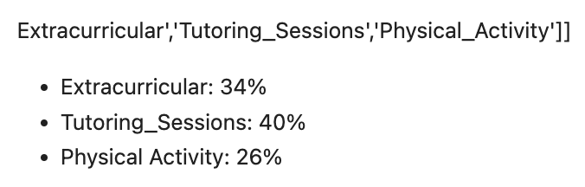
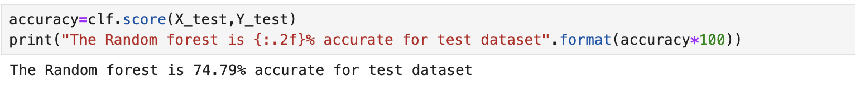
Random Forests Model (Q1)
Random Forests Tuning
Training/Testing Data (70/30)
Notes:
-STEVEN
Since both the training and test accuracy are the near same (75.43% vs 74.49 ), it indicates that the model is neither overfitting (i.e., performing too well on the training data but poorly on the test data) nor underfitting (i.e., not capturing enough patterns in both datasets). This suggests balanced performance and reliable generalization to new, unseen data.

Slide 24
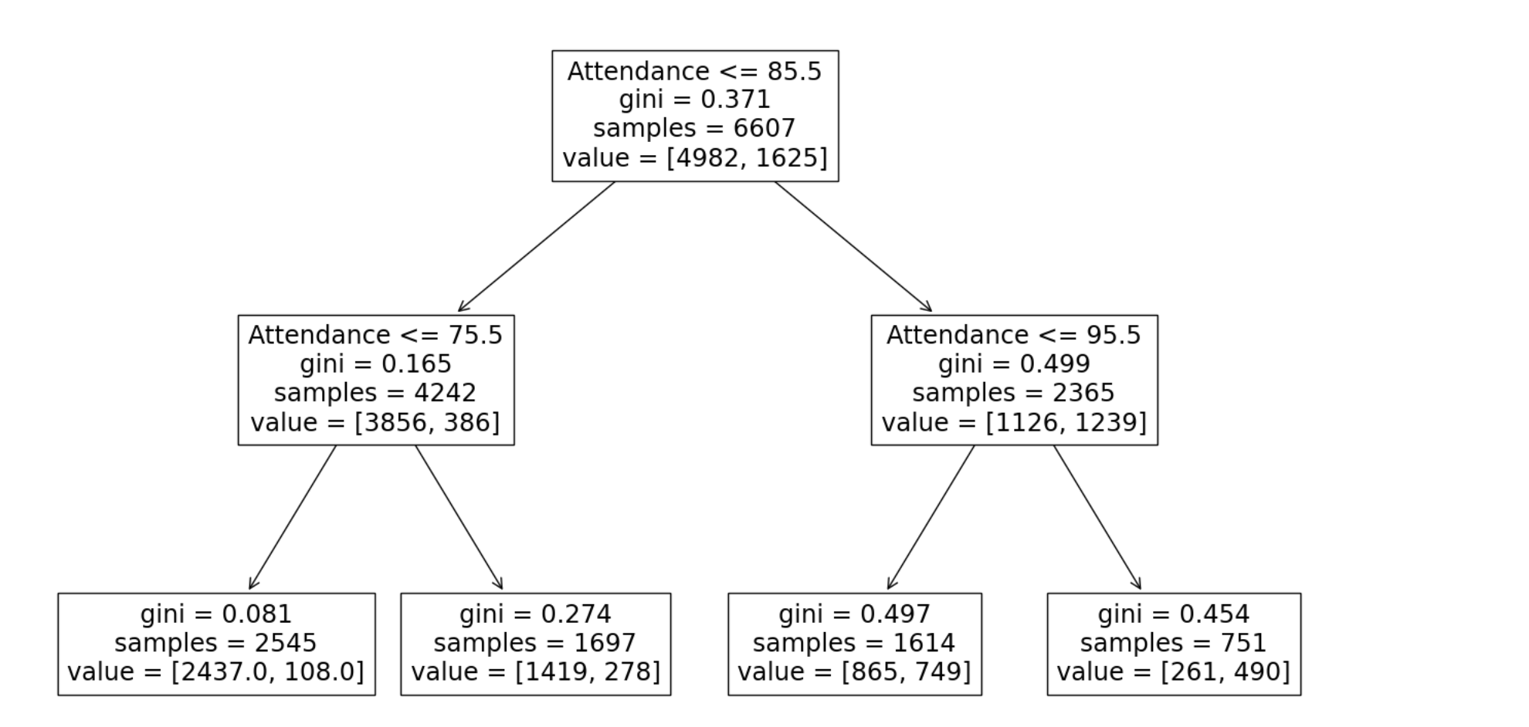
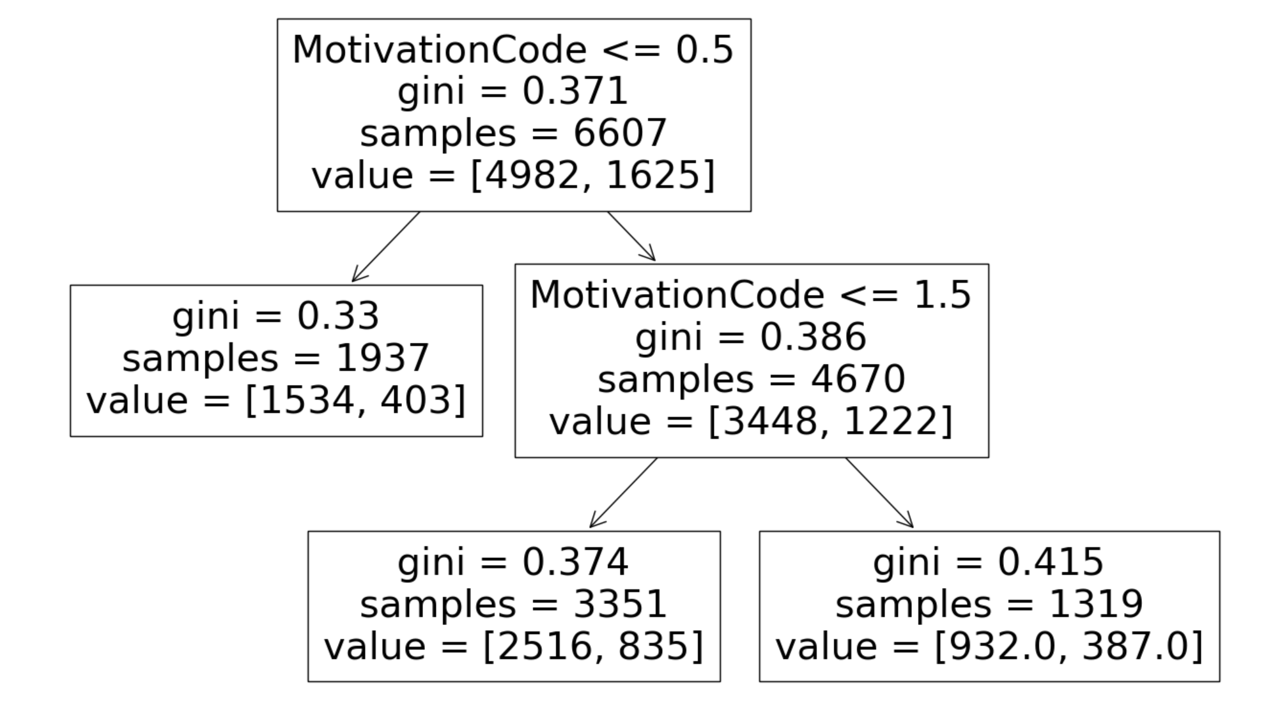
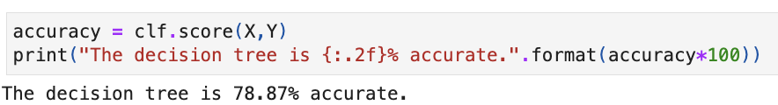
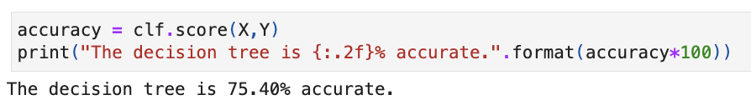
Decision Trees (Q2)
Notes:
NICK
LEFT: measuring attendance and exam scores
RIGHT: measuring motivation code and exam code

Slide 25
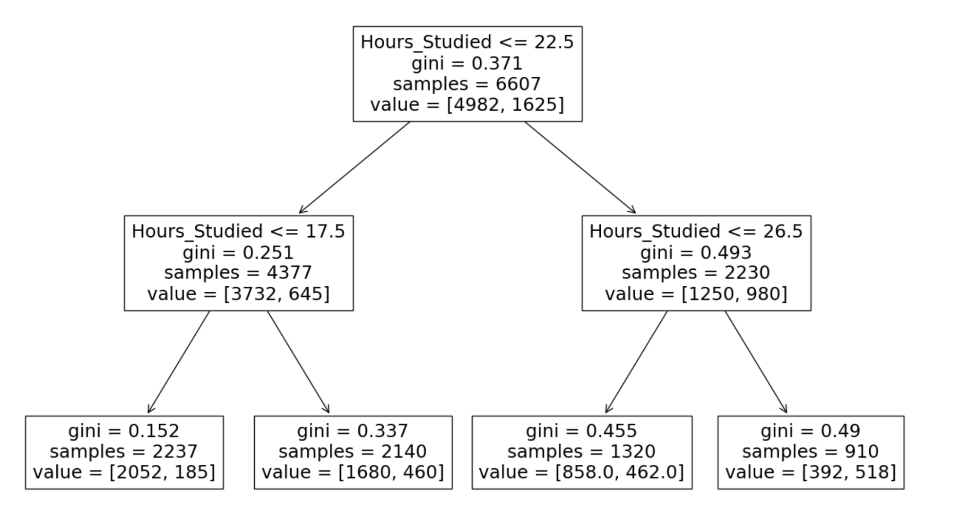
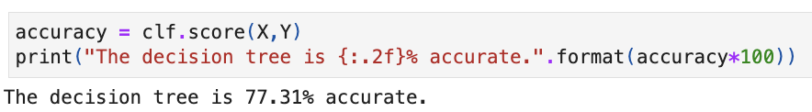
Decision Trees (Q3)
Notes:
Measuring Hours_Studied and Distance Code Variable
-NICK

Slide 26
Results
And
Recommendations
Notes:
-steven

Slide 27
Results
Attendance, the number of hours studied, and tutoring sessions were factors that had the biggest influence on student performance
Distance from home, sleep hours, extracurriculars, and physical activity did not have a significant influence on student performance
Notes:
-WILL

Slide 28
Recommendations
If students want to increase their exam scores, effective ways of doing so would include getting to class, attending tutoring sessions, and focusing on studying
Additional Recommendations:
Pair Attendance With Engagement
Join Study Groups
Incorporate Healthy Habits
Social Connections, Exercise, Time Management
Notes:
-STEVEN

Slide 29
Questions?

